Slide 1
CS2005 Database Systems
Fall 2021
National University of Computer and Emerging Sciences

Slide 2
CHAPTER 14
Basics of Functional Dependencies and Normalization for Relational Databases

Slide 3
Normalization || Data Normalization
Normalization is the process of reorganizing/restructuring data in a database with a series of so called normal-forms, so that it meets two basic requirements:
There is no redundancy of data (all data is stored in only one place), and
Data dependencies are logical (all related data items are stored together)
Normalization is important for many reasons, but chiefly because it allows databases to take up as little disk space as possible, resulting in increased performance.

Slide 4
1. Informal Design Guidelines for Relational Databases (1)
What is relational database design?
The grouping of attributes to form "good" relation schemas
Two levels of relation schemas
The logical "user view" level
The storage "base relation" level
Design is concerned mainly with base relations
What are the criteria for "good" base relations?
Notes:
we group attributes to form a relation schema, we assume that attributes belonging to one relation have certain real-world meaning and a proper interpretation associated with them

Slide 5
Informal Design Guidelines for Relational Databases (2)
We first discuss informal guidelines for good relational design
Then we discuss formal concepts of functional dependencies and normal forms
- 1NF (First Normal Form)
- 2NF (Second Normal Form)
- 3NF (Third Normal Form)
- BCNF (Boyce-Codd Normal Form)
Additional types of dependencies, further normal forms, relational design algorithms by synthesis are discussed in Chapter 15

Slide 6
1.1 Semantics of the Relational Attributes must be clear
GUIDELINE 1: Informally, each tuple in a relation should represent one entity or relationship instance. (Applies to individual relations and their attributes).
Attributes of different entities (EMPLOYEEs, DEPARTMENTs, PROJECTs) should not be mixed in the same relation
Only foreign keys should be used to refer to other entities
Entity and relationship attributes should be kept apart as much as possible.
Bottom Line: Design a schema that can be explained easily relation by relation. The semantics of attributes should be easy to interpret.

Slide 7
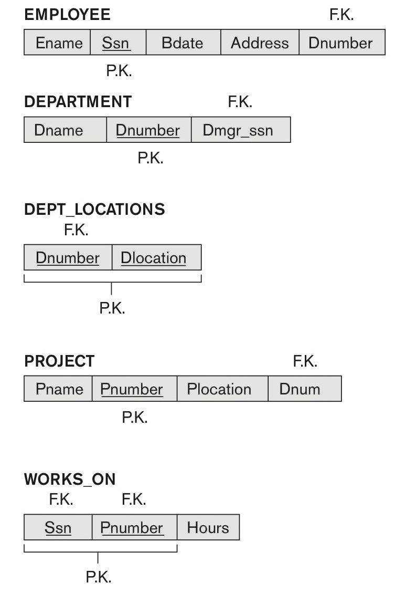
Figure 14.1 A simplified COMPANY relational database schema

Slide 8
1.2 Redundant Information in Tuples and Update Anomalies
Information is stored redundantly
Wastes storage
Causes problems with update anomalies
Insertion Anomalies
Deletion Anomalies
Modification Anomalies

Slide 9
EXAMPLE OF AN UPDATE ANOMALY
Consider the relation:
EMP_PROJ(Emp#, Proj#, Ename, Pname, No_hours)
Update Anomaly:
Changing the name of project number P1 from “Billing” to “Customer-Accounting” may cause this update to be made for all 100 employees working on project P1.

Slide 10
EXAMPLE OF AN INSERT ANOMALY
Consider the relation:
EMP_PROJ(Emp#, Proj#, Ename, Pname, No_hours)
Insert Anomaly:
Cannot insert a project unless an employee is assigned to it.
Conversely
Cannot insert an employee unless an he/she is assigned to a project.

Slide 11
EXAMPLE OF A DELETE ANOMALY
Consider the relation:
EMP_PROJ(Emp#, Proj#, Ename, Pname, No_hours)
Delete Anomaly:
When a project is deleted, it will result in deleting all the employees who work on that project.
Alternately, if an employee is the sole employee on a project, deleting that employee would result in deleting the corresponding project.

Slide 12
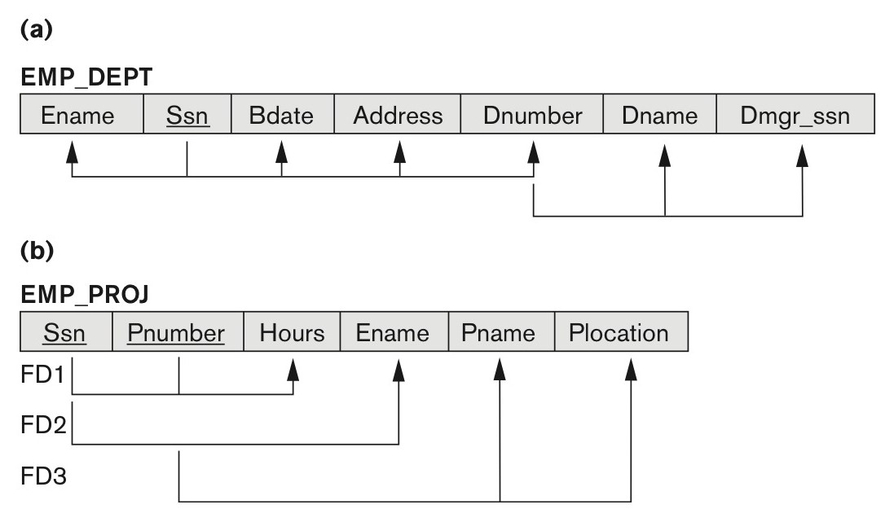
Figure 14.3
Two relation schemas suffering from update anomalies. (a) EMP_DEPT and (b) EMP_PROJ.

Slide 13
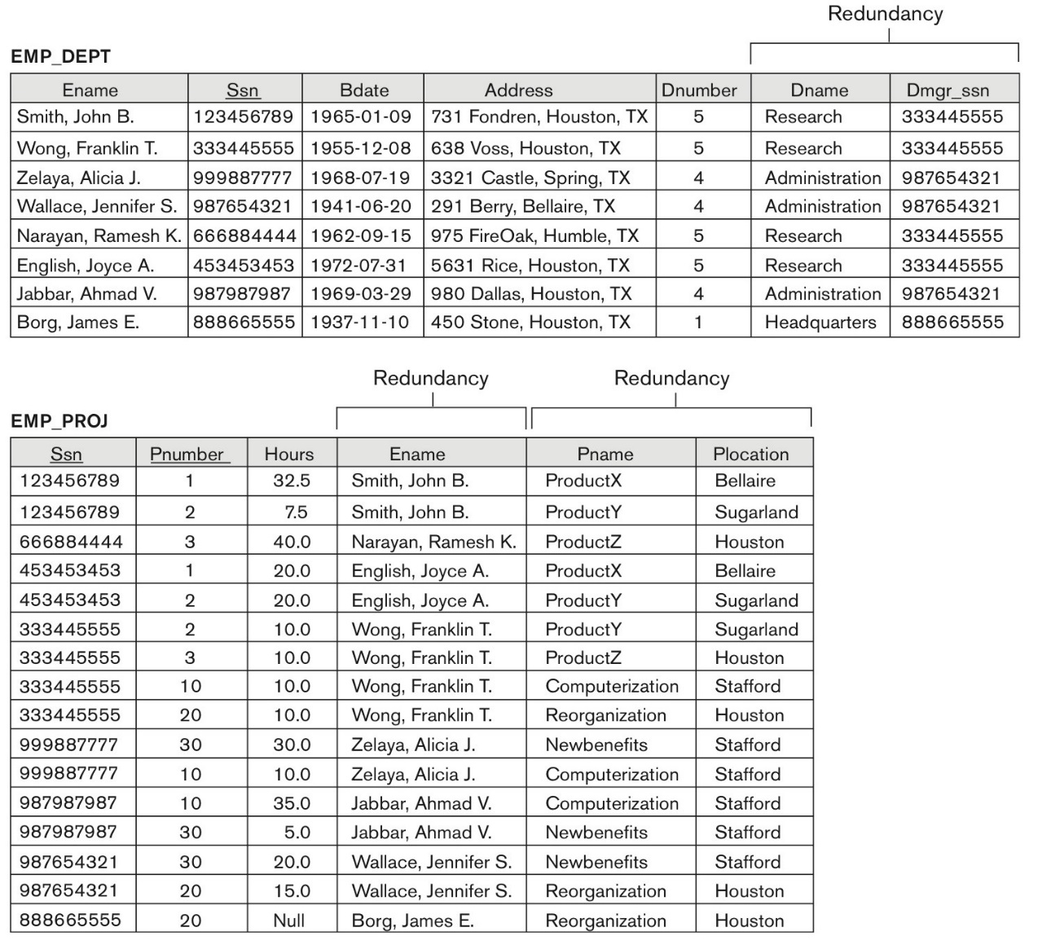
Figure 14.4
Sample states for EMP_DEPT and EMP_PROJ resulting from applying NATURAL JOIN to the relations in Figure 14.2. These may be stored as base relations for performance reasons.

Slide 14
Guideline for Redundant Information in Tuples and Update Anomalies
GUIDELINE 2:
Design a schema that does not suffer from the insertion, deletion and update anomalies.
If there are any anomalies present, then note them so that applications can be made to take them into account.

Slide 15
1.3 Null Values in Tuples
GUIDELINE 3
Relations should be designed such that their tuples will have as few NULL values as possible
Attributes that are NULL frequently could be placed in separate relations (with the primary key)
Reasons for nulls:
Attribute not applicable or invalid (e.g. Visa_Status may not apply to local students)
Attribute value unknown (may exist) (e.g. Date_of_birth may be unknown for an employee)
Value known to exist, but unavailable (e.g. Home_Phone_Number for an employee may exist, but may not be available and recorded yet.

Slide 16
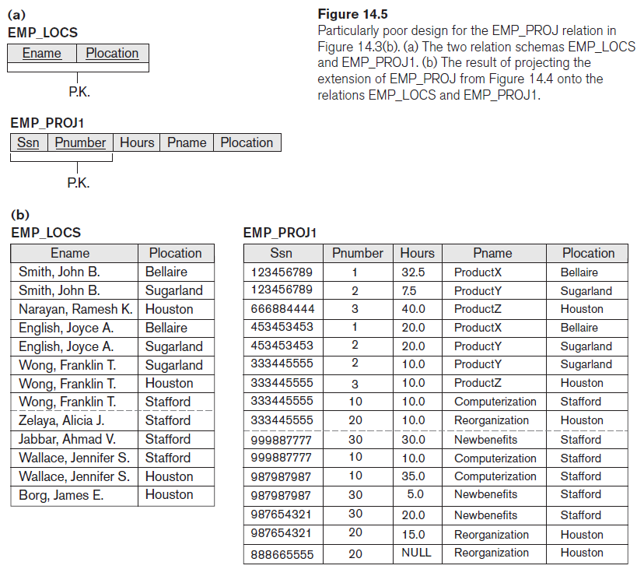
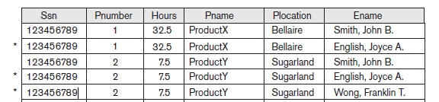
Select *
from EMP_LOCS natural join EMP_PROJ1
where SSN = 123456789;

Slide 17
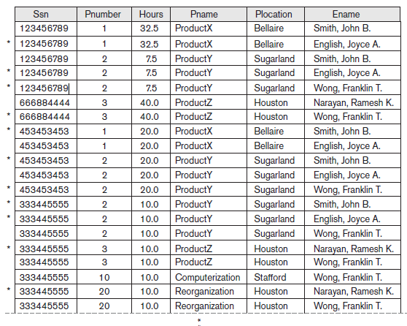
Select *
from EMP_LOCS natural join EMP_PROJ1;

Slide 18
1.4 Generation of Spurious Tuples – avoid at any cost
Design relation schemas so that they can be joined with equality conditions on attributes that are appropriately related (primary key, foreign key) pairs in a way that guarantees that no spurious tuples are generated.
Avoid relations that contain matching attributes that are not (foreign key, primary key) combinations because joining on such attributes may produce spurious tuples.
Bad designs for a relational database may result in erroneous results for certain JOIN operations
The "lossless join" property is used to guarantee meaningful results for join operations
GUIDELINE 4:
The relations should be designed to satisfy the lossless join condition.
No spurious tuples should be generated by doing a natural-join of any relations.

Slide 19
Spurious Tuples (2)
There are two important properties of decompositions:
Non-additive or losslessness of the corresponding join
Preservation of the functional dependencies.
Note that:
Property (a) is extremely important and cannot be sacrificed.
Property (b) is less stringent and may be sacrificed. (See Chapter 15).

Slide 20
2. Functional Dependencies
Functional dependencies (FDs)
Are used to specify formal measures of the "goodness" of relational designs
And keys are used to define normal forms for relations
Are constraints that are derived from the meaning and interrelationships of the data attributes
A set of attributes X functionally determines a set of attributes Y if the value of X determines a unique value for Y

Slide 21
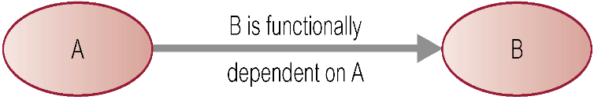
2.1 Defining Functional Dependencies
If A and B are attributes of relation R, B is functionally dependent on A (denoted A → B), if each value of A in R is associated with exactly one value of B in R.
X  Y holds if whenever two tuples have the same value for X, they must have the same value for Y
For any two tuples t1 and t2 in any relation instance r(R): If t1[X]=t2[X], then t1[Y]=t2[Y]
X  Y in R specifies a constraint on all relation instances r(R)
Written as X  Y; can be displayed graphically on a relation schema as in Figures. ( denoted by the arrow: ).
FDs are derived from the real-world constraints on the attributes

Slide 22
Examples of FD constraints (1)
Social security number determines employee name
SSN  ENAME
Project number determines project name and location
PNUMBER  {PNAME, PLOCATION}
Employee ssn and project number determines the hours per week that the employee works on the project
{SSN, PNUMBER}  HOURS

Slide 23
Examples of FD constraints (2)
An FD is a property of the attributes in the schema R
The constraint must hold on every relation instance r(R)
If K is a key of R, then K functionally determines all attributes in R
(since we never have two distinct tuples with t1[K]=t2[K])

Slide 24
Defining FDs from instances
Note that in order to define the FDs, we need to understand the meaning of the attributes involved and the relationship between them.
An FD is a property of the attributes in the schema R
Given the instance (population) of a relation, all we can conclude is that an FD may exist between certain attributes.
What we can definitely conclude is – that certain FDs do not exist because there are tuples that show a violation of those dependencies.

Slide 25
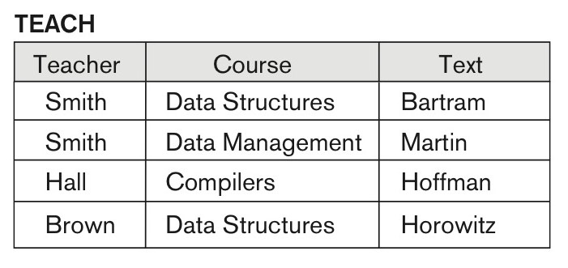
Figure 14.7 Ruling Out FDs
Note that given the state of the TEACH relation, we can say that the FD: Text → Course may exist. However, the FDs Teacher → Course, Teacher → Text and
Couse → Text are ruled out.

Slide 26
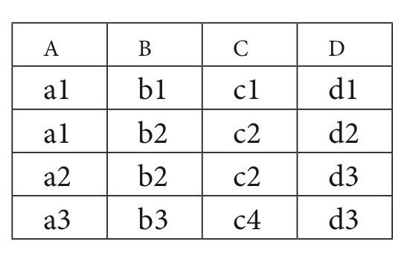
Figure 14.8 What FDs may exist?
FD holds
B -> C
C -> B
{A,B} -> C
{A,B} -> D
{A,C} -> B
{A,C} -> D
{A,D} -> B
{A,D} -> C
{B,D} -> A
{B,D} -> C
{C,D} -> A
{C,D} -> B
{A,B,C} -> D
{A,B,D} -> C
{B,C,D} -> A
FD not holds
A -> B
A -> C
A -> D
B -> A
B -> D
C -> A
C -> D
D -> A
D -> B
D -> C
{B,C} -> A
{B,C} -> D
A relation R(A, B, C, D) with its extension.
Which FDs may exist in this relation?

Slide 27
Important Definitions
Determinant
Refers to the attribute, or group of attributes, on the left-hand side of the arrow of a functional dependency.
Full Functional dependency:
Indicates that if A and B are attributes of a relation, B is fully functionally dependent on A if B is functionally dependent on A, but not on any proper subset of A.
{StaffNo, StaffName} → BranchNo
StaffNo → BranchNo
Transitive Dependency
A condition where A, B, and C are attributes of a relation such that if A → B and B → C, then C is transitively dependent on A via B (provided that A is not functionally dependent on B or C).

Slide 28
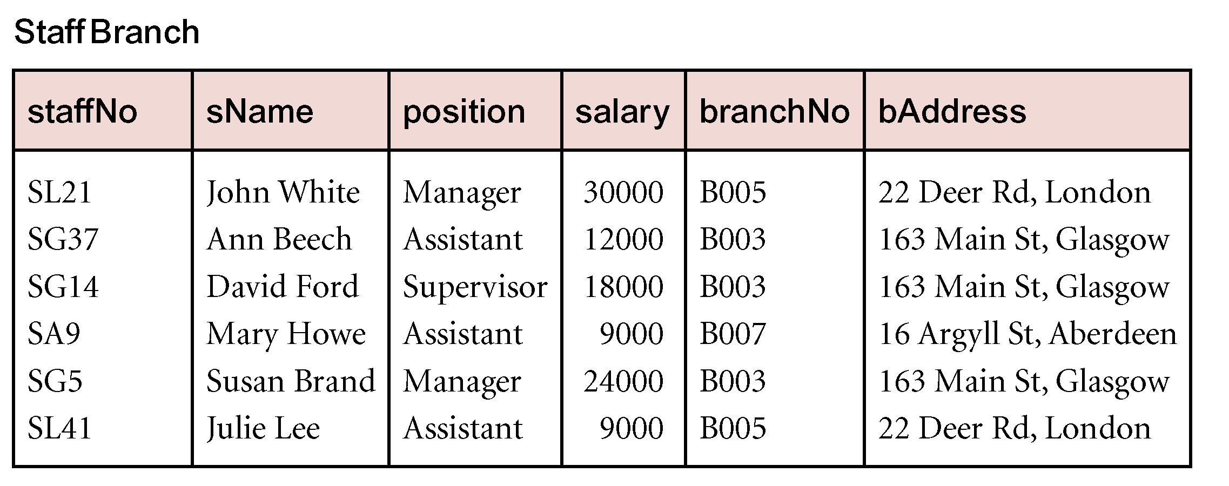
Example Transitive Dependency
Consider functional dependencies in the StaffBranch relation
staffNo → sName, position, salary, branchNo, bAddress
branchNo → bAddress
Transitive dependency,
branchNo → bAddress exists on staffNo via branchNo

Slide 29
3.1 Normalization of Relations (1)
Normalization:
The process of decomposing unsatisfactory "bad" relations by breaking up their attributes into smaller relations
Normal form:
Condition using keys and FDs of a relation to certify whether a relation schema is in a particular normal form

Slide 30
Normalization of Relations (2)
2NF, 3NF, BCNF
based on keys and FDs of a relation schema
4NF
based on keys, multi-valued dependencies : MVDs;
5NF
based on keys, join dependencies : JDs
Additional properties may be needed to ensure a good relational design (lossless join, dependency preservation)

Slide 31
3.2 Practical Use of Normal Forms
Normalization is carried out in practice so that the resulting designs are of high quality and meet the desirable properties
The practical utility of these normal forms becomes questionable when the constraints on which they are based are hard to understand or to detect
The database designers need not normalize to the highest possible normal form
(usually up to 3NF and BCNF. 4NF rarely used in practice.)
Denormalization:
The process of storing the join of higher normal form relations as a base relation—which is in a lower normal form

Slide 32
3.3 Definitions of Keys and Attributes Participating in Keys (1)
A superkey of a relation schema R = {A1, A2, ...., An} is a set of attributes S subset-of R with the property that no two tuples t1 and t2 in any legal relation state r of R will have t1[S] = t2[S]
A key K is a superkey with the additional property that removal of any attribute from K will cause K not to be a superkey any more.

Slide 33
Definitions of Keys and Attributes Participating in Keys (2)
If a relation schema has more than one key, each is called a candidate key.
One of the candidate keys is arbitrarily designated to be the primary key, and the others are called secondary keys.
A Prime attribute must be a member of some candidate key
A Nonprime attribute is not a prime attribute—that is, it is not a member of any candidate key

Slide 34

3.4 First Normal Form
Disallows
composite attributes
multivalued attributes (no repeating group)
nested relations; attributes whose values for an individual tuple are non-atomic (Composite)
Considered to be part of the definition of a relation
Most RDBMSs allow only those relations to be defined that are in First Normal Form

Slide 35
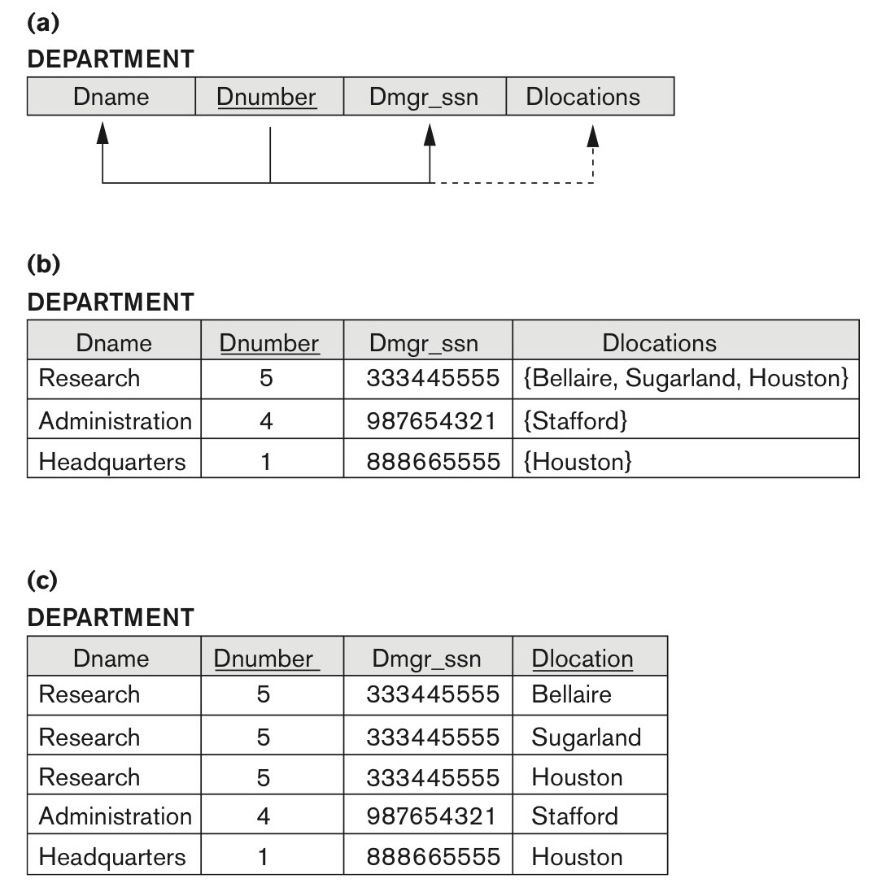
Figure 14.9
Normalization into 1NF. (a) A relation schema that is not in 1NF. (b) Sample state of relation DEPARTMENT. (c) 1NF version of the same relation with redundancy.

Slide 36

Figure 14.10
Normalizing nested relations into 1NF. (a) Schema of the EMP_PROJ relation with a nested relation attribute PROJS. (b) Sample extension of the EMP_PROJ relation showing nested relations within each tuple. (c) Decomposition of EMP_PROJ into relations EMP_PROJ1 and EMP_PROJ2 by propagating the primary key.

Slide 37
3.5 Second Normal Form (1)
Uses the concepts of FDs, primary key
Definitions
Prime attribute: An attribute that is member of the primary key K
Full functional dependency: a FD Y -> Z where removal of any attribute from Y means the FD does not hold any more
Examples:
{SSN, PNUMBER} -> HOURS is a full FD since neither SSN -> HOURS nor PNUMBER -> HOURS hold
{SSN, PNUMBER} -> ENAME is not a full FD (it is called a partial dependency ) since SSN -> ENAME also holds

Slide 38
Second Normal Form (2)
A relation schema R is in second normal form (2NF) if every non-prime attribute A in R is fully functionally dependent on the primary key
R can be decomposed into 2NF relations via the process of 2NF normalization or “second normalization”

Slide 39
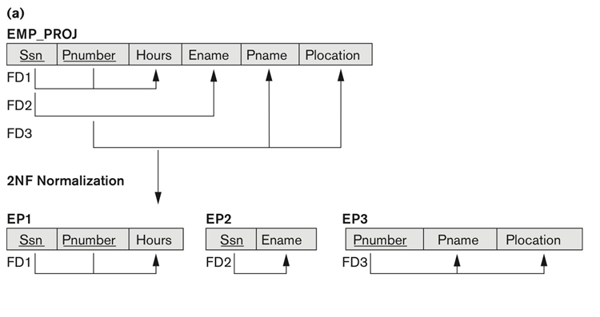
Figure 14.11
Normalizing into 2NF and 3NF. (a) Normalizing EMP_PROJ into 2NF relations. (b) Normalizing EMP_DEPT into 3NF relations.

Slide 40
3.6 Third Normal Form (1)
Definition:
Transitive functional dependency: a FD X -> Z that can be derived from two FDs X -> Y and Y -> Z
Examples:
SSN -> DMGRSSN is a transitive FD
Since SSN -> DNUMBER and DNUMBER -> DMGRSSN hold
SSN -> ENAME is non-transitive
Since there is no set of attributes X where SSN -> X and X -> ENAME

Slide 41
Third Normal Form (2)
A relation schema R is in third normal form (3NF) if it is in 2NF and no non-prime attribute A in R is transitively dependent on the primary key
R can be decomposed into 3NF relations via the process of 3NF normalization
NOTE:
In X -> Y and Y -> Z, with X as the primary key, we consider this a problem only if Y is not a candidate key.
When Y is a candidate key, there is no problem with the transitive dependency .
E.g., Consider EMP (SSN, Emp#, Salary ).
Here, SSN -> Emp# -> Salary and Emp# is a candidate key.

Slide 42
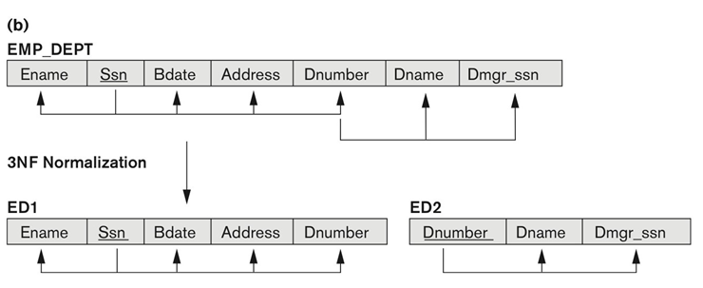
Figure 14.11
Normalizing into 2NF and 3NF. (b) Normalizing EMP_DEPT into 3NF relations.

Slide 43
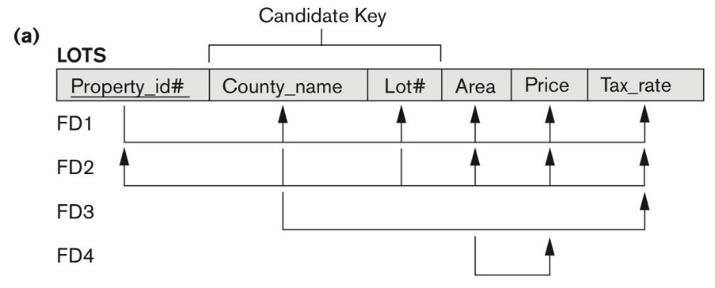
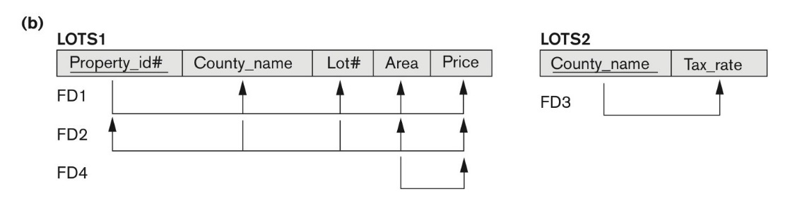
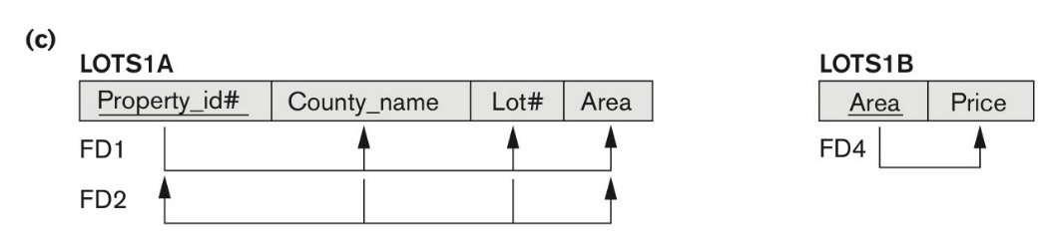
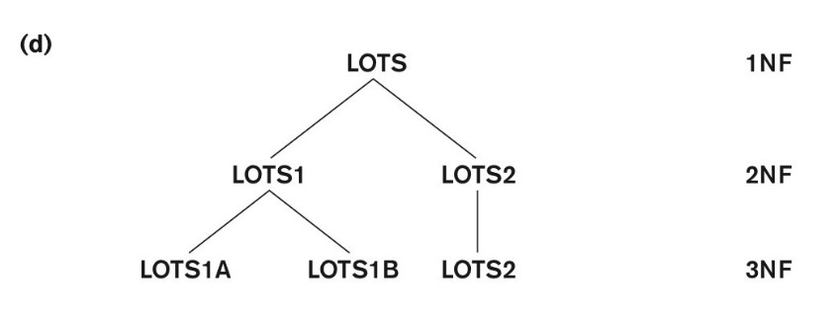
Tax_rate is partially dependent on the candidate key
Price is transitively dependent on each of the candidate keys via non-prime attribute area
Figure 14.12 Normalization into 2NF and 3NF. (a) The LOTS relation with its functional dependencies FD1 through FD4.
(b) Decomposing into the 2NF relations LOTS1 and LOTS2. (c) Decomposing LOTS1 into the 3NF relations LOTS1A and LOTS1B. (d) Progressive normalization of LOTS into a 3NF design.

Slide 44
Normal Forms Defined Informally
1st normal form
All attributes depend on the key
2nd normal form
All attributes depend on the whole key
3rd normal form
All attributes depend on nothing but the key

Slide 45
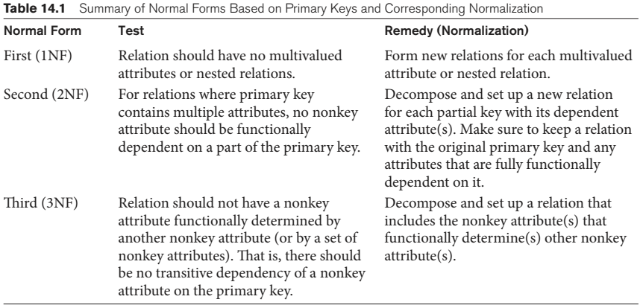

Slide 46
3NF
No Non-Prime attribute is transitively dependent on any candidate key
BCNF (Boyce-Codd Normal Form)
Every determinant is a candidate key
every relation in BCNF is also in 3NF; however, a relation in 3NF is not necessarily in BCNF

Slide 47
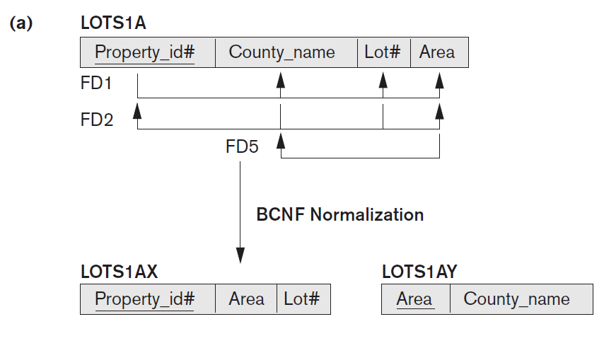
Suppose that we have thousands of lots in the relation, but the lots are from only two counties: Punjab and Sindh.
Suppose also that lot sizes in Punjab County are only
0.5, 0.6, 0.7, 0.8, 0.9, and 1.0 acres, whereas
lot sizes in Sindh County are restricted to
1.1, 1.2, … , 1.9, and 2.0 acres.
In such a situation we would have the additional functional dependency FD5: Area → County_name.

Slide 48
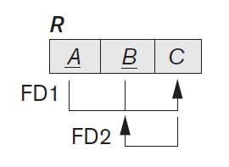
The table above is in 3NF but not in BCNF, because of the C → B

Slide 49
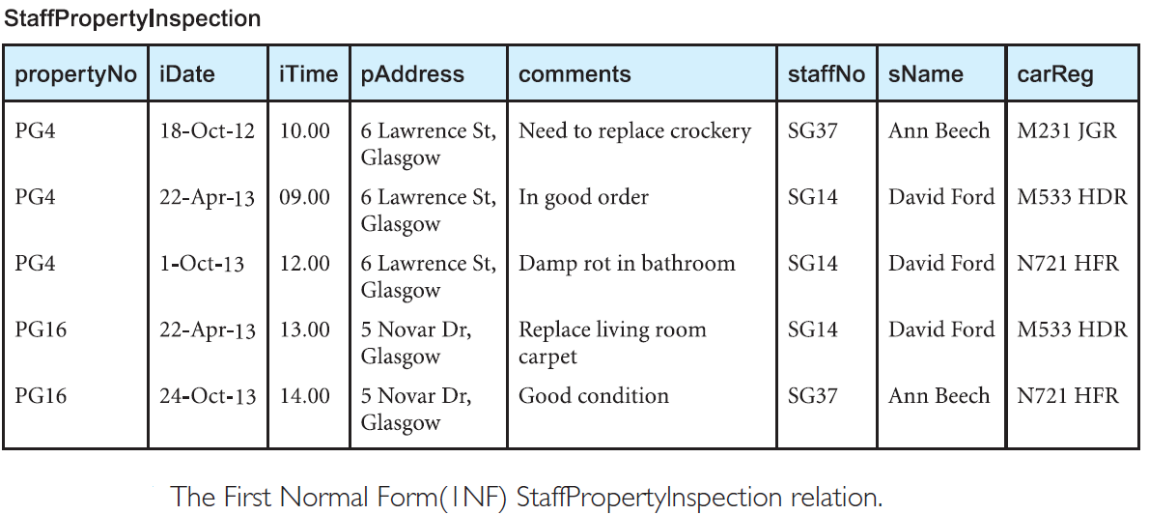

Slide 50
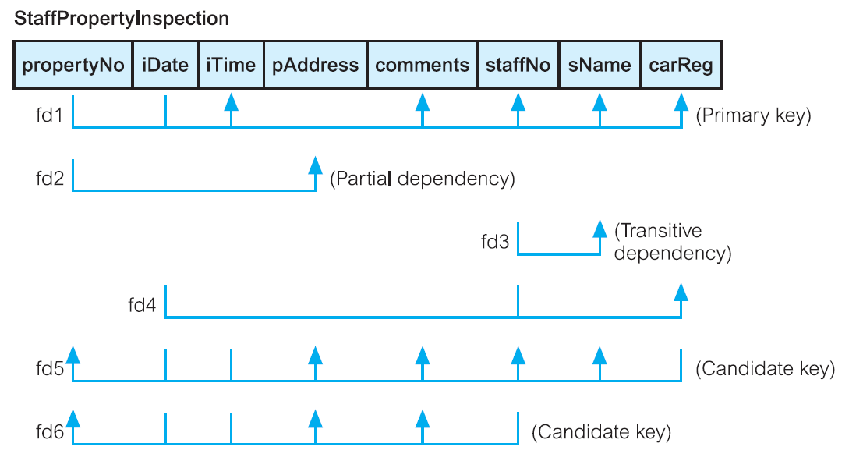
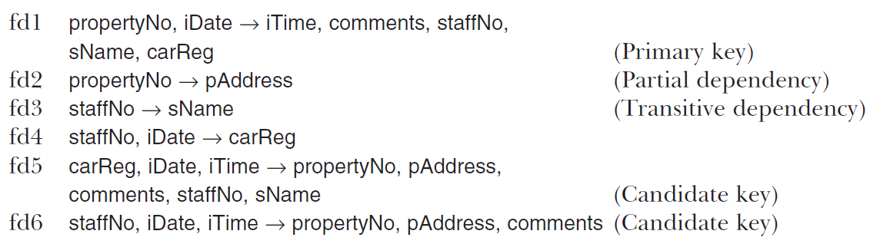

Slide 51

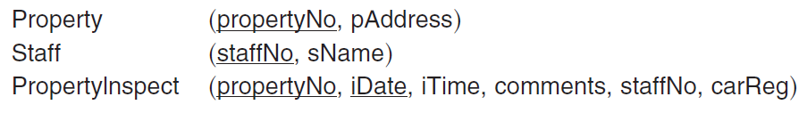
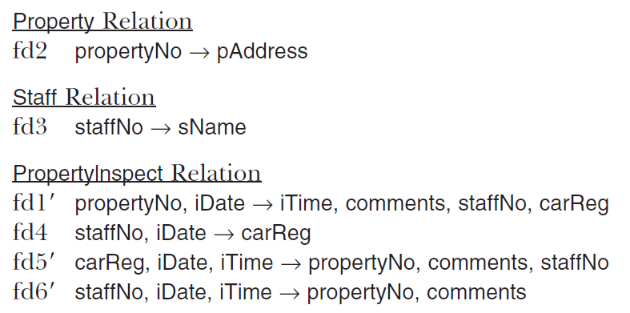

Second Normal Form (2NF)
Third Normal Form (3NF)
Boyce–Codd Normal Form (BCNF)

Slide 52
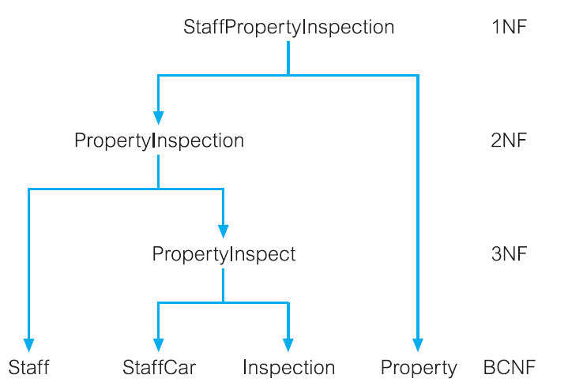

Slide 53
4. General Normal Form Definitions (For Multiple Keys) (1)
The above definitions consider the primary key only
The following more general definitions take into account relations with multiple candidate keys
Any attribute involved in a candidate key is a prime attribute
All other attributes are called non-prime attributes.

Slide 54
4.1 General Definition of 2NF (For Multiple Candidate Keys)
A relation schema R is in second normal form (2NF) if every non-prime attribute A in R is fully functionally dependent on every key of R
In Figure 14.12 the FD
County_name → Tax_rate violates 2NF.
So second normalization converts LOTS into
LOTS1 (Property_id#, County_name, Lot#, Area, Price)
LOTS2 ( County_name, Tax_rate)

Slide 55
4.2 General Definition of Third Normal Form
Definition:
Superkey of relation schema R - a set of attributes S of R that contains a key of R
A relation schema R is in third normal form (3NF) if whenever a FD X → A holds in R, then either:
(a) X is a superkey of R, or
(b) A is a prime attribute of R
LOTS1 relation violates 3NF because
Area → Price ; and Area is not a superkey in LOTS1. (see Figure 14.12).

Slide 56
4.3 Interpreting the General Definition of Third Normal Form
Consider the 2 conditions in the Definition of 3NF:
A relation schema R is in third normal form (3NF) if whenever a FD X → A holds in R, then either:
(a) X is a superkey of R, or
(b) A is a prime attribute of R
Condition (a) catches two types of violations :
one where a prime attribute functionally determines a non-prime attribute. This catches 2NF violations due to non-full functional dependencies
second, where a non-prime attribute functionally determines a non-prime attribute. This catches 3NF violations due to a transitive dependency

Slide 57
4.3 Interpreting the General Definition of Third Normal Form (2)
ALTERNATIVE DEFINITION of 3NF: We can restate the definition as:
A relation schema R is in third normal form (3NF) if every non-prime attribute in R meets both of these conditions:
It is fully functionally dependent on every key of R
It is non-transitively dependent on every key of R
Note that stated this way, a relation in 3NF also meets the requirements for 2NF.
The condition (b) from the last slide takes care of the dependencies that “slip through” (are allowable to) 3NF but are “caught by” BCNF which we discuss next.

Slide 58
5. BCNF (Boyce-Codd Normal Form)
A relation schema R is in Boyce-Codd Normal Form (BCNF) if whenever an FD X → A holds in R, then X is a superkey of R
Each normal form is strictly stronger than the previous one
Every 2NF relation is in 1NF
Every 3NF relation is in 2NF
Every BCNF relation is in 3NF
There exist relations that are in 3NF but not in BCNF
Hence BCNF is considered a stronger form of 3NF
The goal is to have each relation in BCNF (or 3NF)

Slide 59

Figure 14.14 A relation TEACH that is in 3NF but not in BCNF
Figure 14.14
A relation TEACH that is in 3NF but not BCNF.

Slide 60
Achieving the BCNF by Decomposition (1)
Two FDs exist in the relation TEACH:
fd1: { student, course} -> instructor
fd2: instructor -> course
{student, course} is a candidate key for this relation and that the dependencies shown follow the pattern in Figure 14.13 (b).
So this relation is in 3NF but not in BCNF
A relation NOT in BCNF should be decomposed so as to meet this property, while possibly forgoing the preservation of all functional dependencies in the decomposed relations.
(See Algorithm 15.3)

Slide 61
Achieving the BCNF by Decomposition (2)
Three possible decompositions for relation TEACH
D1: {student, instructor} and {student, course}
D2: {course, instructor } and {course, student}
D3: {instructor, course } and {instructor, student} ✓
All three decompositions will lose fd1.
We have to settle for sacrificing the functional dependency preservation. But we cannot sacrifice the non-additivity property after decomposition.
Out of the above three, only the 3rd decomposition will not generate spurious tuples after join.(and hence has the non-additivity property).
A test to determine whether a binary decomposition (decomposition into two relations) is non-additive (lossless) is discussed under Property NJB on the next slide. We then show how the third decomposition above meets the property

Slide 62
Test for checking non-additivity of Binary Relational Decompositions
Testing Binary Decompositions for Lossless Join (Non-additive Join) Property
Binary Decomposition: Decomposition of a relation R into two relations.
PROPERTY NJB (non-additive join test for binary decompositions): A decomposition D = {R1, R2} of R has the lossless join property with respect to a set of functional dependencies F on R if and only if either
The f.d. ((R1 ∩ R2)  (R1- R2)) is in F⁺, or
The f.d. ((R1 ∩ R2)  (R2 - R1)) is in F⁺.

Slide 63
Test for checking non-additivity of Binary Relational Decompositions
If you apply the NJB test to the 3 decompositions of the TEACH relation:
D1 gives Student  Instructor or Student  Course, none of which is true.
D2 gives Course  Instructor or Course  Student, none of which is true.
However, in D3 we get Instructor  Course or Instructor  Student.
Since Instructor  Course is indeed true, the NJB property is satisfied and D3 is determined as a non-additive (good) decomposition.

Slide 64
General Procedure for achieving BCNF when a relation fails BCNF
Here we make use the algorithm from Chapter 15 (Algorithm 15.5):
Let R be the relation not in BCNF, let X be a subset-of R, and let X → A be the FD that causes a violation of BCNF. Then R may be decomposed into two relations:
(i) R –A and (ii) X υ A.
If either R –A or X υ A. is not in BCNF, repeat the process.
Note that the f.d. that violated BCNF in TEACH was Instructor →Course. Hence its BCNF decomposition would be :
(TEACH – COURSE) and (Instructor υ Course), which gives the relations: (Instructor, Student) and (Instructor, Course) that we obtained before in decomposition D3.

Slide 65
5. Multivalued Dependencies and Fourth Normal Form (1)
Definition:
A multivalued dependency (MVD) X —>> Y specified on relation schema R, where X and Y are both subsets of R, specifies the following constraint on any relation state r of R: If two tuples t₁ and t₂ exist in r such that t₁[X] = t₂[X], then two tuples t₃ and t₄ should also exist in r with the following properties, where we use Z to denote (R 2 (X υ Y)):
t₃[X] = t₄[X] = t₁[X] = t₂[X].
t₃[Y] = t₁[Y] and t₄[Y] = t₂[Y].
t₃[Z] = t₂[Z] and t₄[Z] = t₁[Z].
An MVD X —>> Y in R is called a trivial MVD if (a) Y is a subset of X, or (b) X υ Y = R.

Slide 66
Multivalued Dependencies and Fourth Normal Form (3)
Definition:
A relation schema R is in 4NF with respect to a set of dependencies F (that includes functional dependencies and multivalued dependencies) if, for every nontrivial multivalued dependency X —>> Y in F⁺, X is a superkey for R.
Note: F⁺ is the (complete) set of all dependencies (functional or multivalued) that will hold in every relation state r of R that satisfies F. It is also called the closure of F.

Slide 67
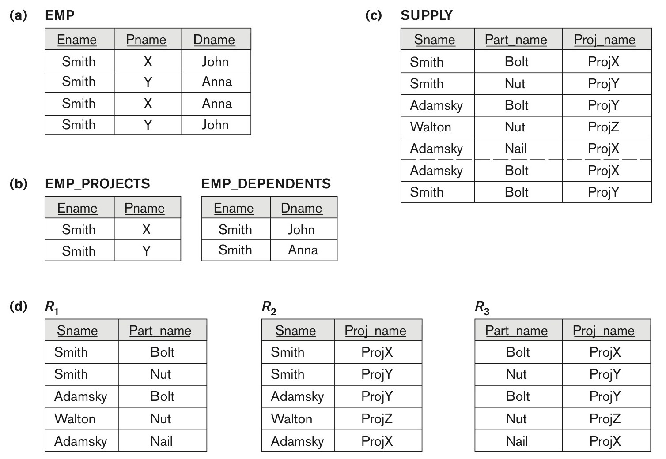
Figure 14.15 Fourth and fifth normal forms.
Figure 14.15
Fourth and fifth normal forms. (a) The EMP relation with two MVDs: Ename –>> Pname and Ename –>> Dname. (b) Decomposing the EMP relation into two 4NF relations EMP_PROJECTS and EMP_DEPENDENTS. (c) The relation SUPPLY with no MVDs is in 4NF but not in 5NF if it has the JD(R1, R2, R3). (d) Decomposing the relation SUPPLY into the 5NF relations R1, R2, R3.

Slide 68
6. Join Dependencies and Fifth Normal Form (1)
Definition:
A join dependency (JD), denoted by JD(R₁, R₂, ..., R_{n}), specified on relation schema R, specifies a constraint on the states r of R.
The constraint states that every legal state r of R should have a non-additive join decomposition into R₁, R₂, ..., R_{n}; that is, for every such r we have
* (π_{R1}(r), π_{R2}(r), ..., π_{Rn}(r)) = r
Note: an MVD is a special case of a JD where n = 2.
A join dependency JD(R₁, R₂, ..., R_{n}), specified on relation schema R, is a trivial JD if one of the relation schemas R_{i} in JD(R₁, R₂, ..., R_{n}) is equal to R.

Slide 69
Join Dependencies and Fifth Normal Form (2)
Definition:
A relation schema R is in fifth normal form (5NF) (or Project-Join Normal Form (PJNF)) with respect to a set F of functional, multivalued, and join dependencies if,
for every nontrivial join dependency JD(R₁, R₂, ..., R_{n}) in F⁺ (that is, implied by F),
every R_{i} is a superkey of R.
Discovering join dependencies in practical databases with hundreds of relations is next to impossible. Therefore, 5NF is rarely used in practice.

